Slide 1
Dog Infographics
Here is where this template begins

Slide 2
Dog infographics
Benefits of living with dogs
Security
Companion
Venus is the second planet from the Sun
Despite being red, Mars is a cold place
Routine
Calmness
Jupiter is the biggest planet of them all
Saturn is a gas giant and has several rings

Slide 3
Dog infographics
Size
9kg
Size
50kg
Agility
Little
Agility
High
Noise
High
Noise
Medium
French Bulldog
Energy
Medium
Rottweiler
Energy
Medium
Size
4kg
Size
10kg
Agility
Medium
Agility
High
Noise
Medium
Noise
Little
Chihuahua
Energy
High
Beagle
Energy
High

Slide 4
Dog infographics
What do they need?
Home
Activity
Walks
Meal
Venus is the second planet from the Sun
Jupiter is the biggest planet of them all
Despite being red, Mars is a cold place
Saturn is a gas giant and has several rings

Slide 5
Dog infographics
Shih Tzu
Origin: China
Weight: 4-8 kgs
Height: 8-11 inches
Lifespan: 10-16 years
Venus has a beautiful name and is the second planet from the Sun. It’s terribly hot
Drool
Snore
Bark
Dig

Slide 6
Dog infographics
Fetch
Kiss
Spin
Basic orders
01
02
03
Mercury is the smallest planet
Jupiter is the biggest planet
Despite being red, Mars is a cold place

Slide 7
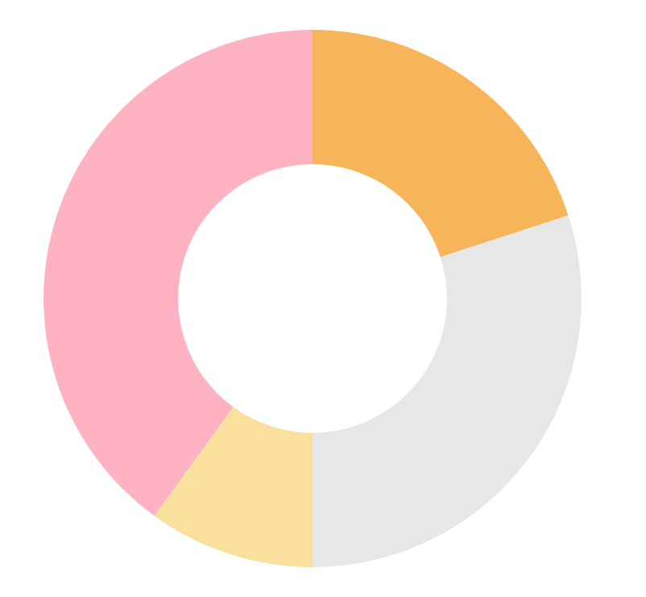
Dog infographics
40%
Chihuahua
20%
Beagle
Jupiter is the biggest planet of them all
Mercury is the smallest planet of them all
10%
Siberian husky
30%
Golden retriever
Despite being red, Mars is a very cold planet
Saturn is a gas giant and has several rings
Follow the link in the graph to modify its data and then paste the new one here. For more info, click here

Slide 8
Dog infographics
 | Eggs
 | Chicken
 | Salmon
 | Carrot
 | Caffeine
 | Chocolat
 | Salt
 | Onions

Slide 9
Dog infographics
Toy
Small
Middle
Big
Saturn is a gas giant and has several rings. It’s composed of hydrogen and helium
Mercury is the closest planet to the Sun and the smallest in the entire Solar System
Venus has a beautiful name and is the second planet from the Sun. It’s terribly hot
Despite being red, Mars is actually a very cold place. It’s full of iron oxide dust

Slide 10
Dog infographics
Bed
Shampoo
Dryer
Toys
Dog Shop
Feed
Thermometer
Medicines
Clothes

Slide 11
Dog infographics
01
02
03
04
05
Venus
Jupiter
Mars
Saturn
Neptune
Venus is the second planet from the Sun
Jupiter is the biggest planet of them all
Despite being red, Mars is a cold place
Saturn is a gas giant and has several rings
Neptune is the farthest planet from the Sun

Slide 12
Dog infographics
Mercury
Mars
Saturn
Neptune
Mercury is the closest planet to the Sun
Despite being red, Mars is actually a cold place
Saturn is a gas giant and has several rings
Neptune is the farthest planet from the Sun

Slide 13
Dog infographics
70%
Despite being red, Mars is actually a cold place
50%
Neptune is the farthest planet from the Sun
30%
Mercury is the closest planet to the Sun
90%
Saturn is a gas giant and has several rings

Slide 14
Dog infographics
Dogs in USA
American Bulldog
Australian Shepherd
White Shepherd
Despite being red, Mars is actually a very cold place. It’s full of iron oxide dust

Slide 15
Dog infographics
70% Big dogs
Jupiter is the biggest planet of them all
50% Medium dogs
Despite being red, Mars is a cold place
90% Small dogs
Saturn is a gas giant and has several rings

Slide 16
Dog infographics
How to brush a dog’s teeth
01
Venus
Venus is the second planet from the Sun
02
Jupiter
Jupiter is the biggest planet of them all
03
Mars
Despite being red, Mars is a cold place
04
Saturn
Saturn is a gas giant and has several rings

Slide 17
Dog infographics
Activity games
Training
Despite being red, Mars is a cold place
Jupiter is a gas giant and the biggest planet
Dog play
Walks to go
Saturn is a gas giant and has several rings
Venus has a beautiful name and it’s hot
Puzzles & toys
Scent work
Neptune is the farthest planet from the Sun
Earth is the third planet from the Sun

Slide 18
Dog infographics
Venus
Mercury
Mars
Venus is the second planet from the Sun
Mercury is the closest planet to the Sun
Despite being red, Mars is a very cold place
Jupiter
Saturn
Neptune
Jupiter is the biggest planet of them all
It’s composed of hydrogen and helium
It’s the farthest planet from the Sun

Slide 19
Dog infographics
Reduces stress
You feel safe
Despite being red, Mars is a cold place
Saturn is a gas giant and has several rings
Keeps you fit
Connects with you
Venus is the second planet from the Sun
Jupiter is the biggest planet of them all

Slide 20
Dog infographics
What you should not do!
Never walk during the mid-day, especially in open sun
Never yell close to his face or ears
Can trim longer haired dogs, but never shaver their coats
Do not force them to socialize with other dogs if they don’t want to
Never ever leave your pets in a parked car. Not even for a minute
Do not force them to eat food that he does not feel like
Don’t rely on a fan, because they don’t cool off pet as effectively as they do people
Do not leave it alone at home for a long time or carry it everywhere

Slide 21
Dog infographics
Afternoon
Despite being red, Mars is actually a cold place
Morning
Evening
Jupiter is the biggest planet of them all
Saturn is a gas giant and has several rings

Slide 22
Dog infographics
75%
25%
Female
Male
Venus has a very beautiful name, but it’s terribly hot
Mercury is the closest planet to the Sun

Slide 23
Dog infographics
01
02
01
02
Mercury
Jupiter
Mars
Earth
Mercury is the closest planet to the Sun
Jupiter is the biggest planet of them all
Despite being red, Mars is a cold place
Earth is the third planet from the Sun

Slide 24
Dog infographics
Why adopt a dog?
01
04
Mercury
Mars
Mercury is the closest planet to the Sun
Despite being red, Mars is a cold place
02
05
Venus
Saturn
Earth is the third planet from the Sun and the only one that harbors life in the Solar System. This is the planet where we all live
Venus has a beautiful name but is hot
Saturn is a gas giant and has several rings
03
06
Earth
Neptune
The Earth is the third planet from the Sun
Neptune is the farthest planet from the Sun

Slide 25
Dog infographics
01
02
The importance of good food
Mercury
Jupiter
Venus has a beautiful name and is the second planet from the Sun
Mercury is the closest planet to the Sun
Jupiter is the biggest planet of them all
03
04
Mars
Earth
Despite being red, Mars is a cold place
Earth is the third planet from the Sun

Slide 26
Dog infographics
Stages of a dog’s life
Breed | Puppies | Adults | Senior
Small | Up to 8 months | More than 8 months | Over 8 years
Middle | Up to 12 months | More than 12 months | Over 7 years
Big | Up to 15 months | More than 15 months | Over 10 years

Slide 27
Dog infographics
Mercury
Mars
01
02
Mercury is the closest planet to the Sun
Despite being red, Mars is a cold place
Venus
Neptune
06
03
Venus has a beautiful name, but it’s hot
Neptune is the farthest planet from the Sun
Earth
Saturn
05
04
The Earth is the third planet from the Sun
Saturn is a gas giant and has several rings

Slide 28
Dog infographics
How to choose a good necklace
01
02
03
Tip
Tip
Tip
Venus has a beautiful name and is the second planet from the Sun
Mercury is the smallest planet and the smallest in the Solar System
Despite being red, Mars is actually a cold place. It’s full of iron oxide dust

Slide 29
Dog infographics
Rabies
Leptospirosis
01
04
Mercury is the smallest planet
Mars is actually a cold place
Bordetella
Parainfluenza
02
05
Venus has a beautiful name
Jupiter is the biggest planet
Lyme
DAP
03
06
Only Saturn
has rings
Neptune is far from the Sun

Slide 30
Dog infographics
60.2 million households
6 Dogs per minute
Are home to dogs in the US
End up in a rescue shelter or humane society
1.6 million dogs
1 in 10 dogs
Are adopted each year
Are returned to shelters within six months of adoption

Slide 31
Dog infographics
Siberian Husky
Sociable
Loyal
Athletic
Friendly
Sensitive
Independent
Lifespan
12-15 years
Foods
Carrot or fish
Positive traits
Highly alert

Slide 32
Icon pack: Dogs

Slide 33
Instructions for use
If you have a free account, in order to use this template, you must credit Slidesgo by keeping the Thanks slide. Please refer to the next slide to read the instructions for premium users.
As a Free user, you are allowed to:
- Modify this template.
- Use it for both personal and commercial projects.
You are not allowed to:
- Sublicense, sell or rent any of Slidesgo Content (or a modified version of Slidesgo Content).
- Distribute Slidesgo Content unless it has been expressly authorized by Slidesgo.
- Include Slidesgo Content in an online or offline database or file.
- Offer Slidesgo templates (or modified versions of Slidesgo templates) for download.
- Acquire the copyright of Slidesgo Content.
For more information about editing slides, please read our FAQs or visit Slidesgo School:
https://slidesgo.com/faqs and https://slidesgo.com/slidesgo-school

Slide 34
Instructions for use (premium users)
As a Premium user, you can use this template without attributing Slidesgo
You are allowed to:
Modify this template.
Use it for both personal and commercial purposes.
Hide or delete the “Thanks” slide and the mention to Slidesgo in the credits.
Share this template in an editable format with people who are not part of your team.
You are not allowed to:
Sublicense, sell or rent this Slidesgo Template (or a modified version of this Slidesgo Template).
Distribute this Slidesgo Template (or a modified version of this Slidesgo Template) or include it in a database or in any other product or service that offers downloadable images, icons or presentations that may be subject to distribution or resale.
Use any of the elements that are part of this Slidesgo Template in an isolated and separated way from this Template.
Register any of the elements that are part of this template as a trademark or logo, or register it as a work in an intellectual property registry or similar.
For more information about editing slides, please read our FAQs or visit Slidesgo School:
https://slidesgo.com/faqs and https://slidesgo.com/slidesgo-school

Slide 35
Infographics
You can add and edit some infographics to your presentation to present your data in a visual way.
Choose your favourite infographic and insert it in your presentation using Ctrl C + Ctrl V or Cmd C + Cmd V in Mac.
Select one of the parts and ungroup it by right-clicking and choosing “Ungroup”.
Change the color by clicking on the paint bucket.
Then resize the element by clicking and dragging one of the square-shaped points of its bounding box (the cursor should look like a double-headed arrow). Remember to hold Shift while dragging to keep the proportions.
Group the elements again by selecting them, right-clicking and choosing “Group”.
Repeat the steps above with the other parts and when you’re done editing, copy the end result and paste it into your presentation.
Remember to choose the “Keep source formatting” option so that it keeps the design. For more info, please visit Slidesgo School.

